Slide 1
CSS-Project Leveraging HTML5 and CSS3
Interface Design Using CSS (COMP 1054)

Slide 2
Table of contents
01
02
03
Introduction
Project Overview
Snapshots
04
05
06
Conclusion
Feedback
Live Demo
Some basic details about project purpose
About project and tech stack being used
Snapshots / Output of deployed website
Closing statement to end presentation
Any valuable suggestion from the audience
Let’s visit live server on GitHub

Slide 3
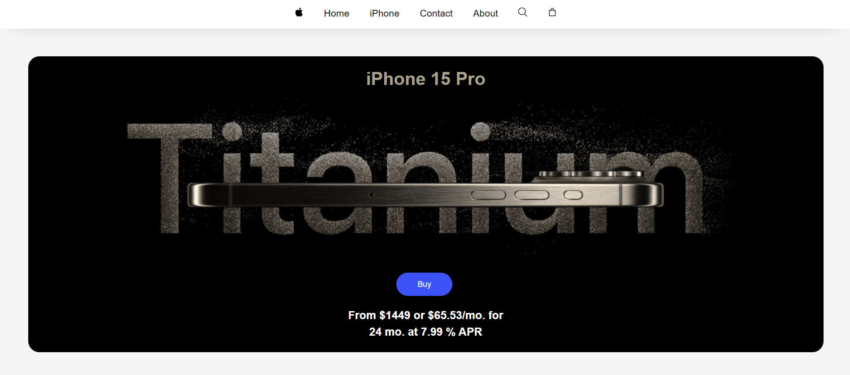
Introduction
The primary objective of this project was to apply and enhance my skills in CSS3 by replicating a small part of apple.com. Apple’s website is known for its clean, user-friendly design and serves as a great inspiration for learning advanced web development techniques.

Slide 4
02.
About the project
Let’s know about the project…

Slide 5
Team Responsibilities
Utsav
Smit
Implements HTML5, CSS3, and Bootstrap components to recreate the design accurately
Testing to ensure the website functions correctly across different devices and browsers
Yash
Aditi
Designs and prototype user interface elements based on apple.com style
Planning on the sketch or outline of website

Slide 6




Tech Stack and Usage
HTML5
CSS3
Bootstrap
GitHub
Used for structured and content organization
Used for Styling, Layout and responsiveness achieved
Used for responsive, component-rich look
Used for deployment of Website

Slide 7



Project Highlights
Design
Responsive
Elements
Achieved a similar look and feel to apple.com segment
Adapted design for various screen sizes using Bootstrap
Enhanced user experience with CSS animations and transitions

Slide 8

Key Features and Elements
Custom Navigation Bar: Recreated the navigation bar with responsive design.
Hero Section: striking hero section with background images and layered text.
Product Card: Designed product showcase cards with hover effects for interactivity.
Typography: Matched Apple’s clean font styles.
Footer: Detail footer with links.

Slide 9
Project Snapshots
03.
Let’s visit our deployed website

Slide 10
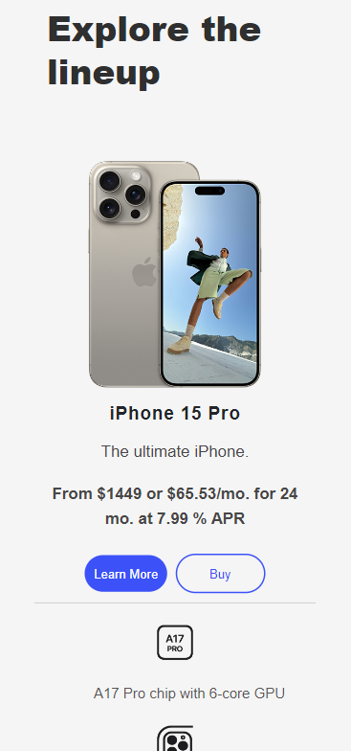
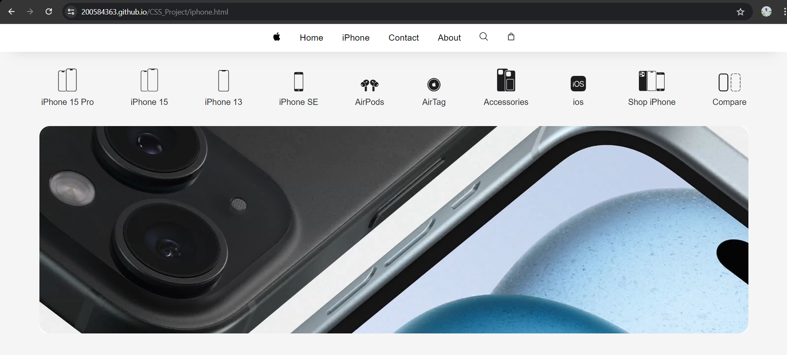

Slide 11
Conclusion
In this project , we successfully recreated a segment of apple.com using HTML5 and CSS3. The focus was demonstrating advanced CSS techniques and achieving a responsive, visually appealing design.
> Key Takeaways:
Mastery of CSS3 features such as Flexbox and Grid.
Practical application of Bootstrap for responsive design.
Enhanced skills in creating interactive and aesthetically pleasing web elements.

Slide 12
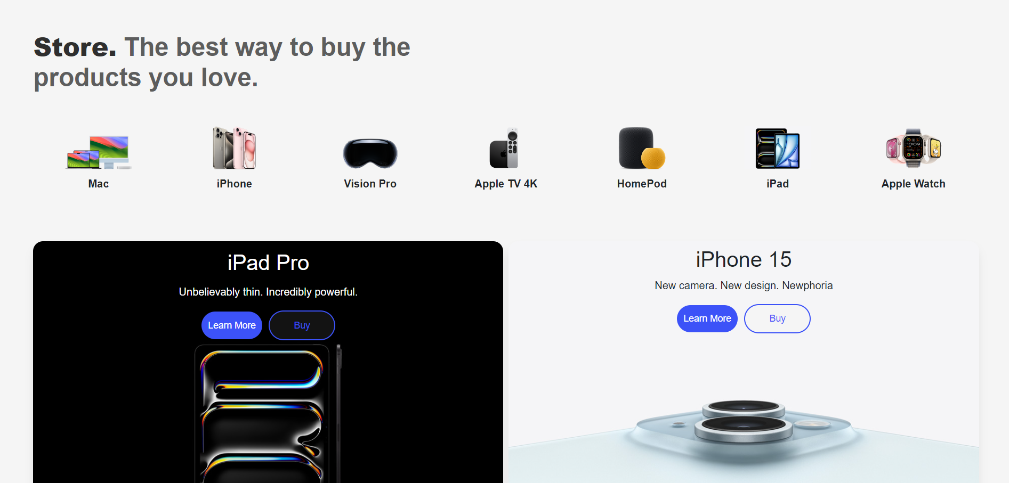
Live Demo of Website
www.utsav.github.com
Let’s visit to utsav/github.com for live demo of our website.

Slide 13

Any Question or Feedback ?

Slide 14
Thanks
CSS transforms HTML into art…

